Slide 1
Introduction into Programming

Slide 2
Contents
What is a Computer Program?
Data TYPES
DATA Declaration
Variables and Constants
Structures
Tables
First ABAP Program
Time to Practice

Slide 3
What is a Computer Program?

Slide 4
Introduction to Programming
What is a Computer Program ?
Computer Program is a sequence of instructions, written using a Computer Programming Language, to perform a specified task by the computer.
The two important terms that we have used in the above definition are:
Sequence of instructions
Computer Programming Language

Slide 5
Steps to Development of Program
Development of programming language is entirely dependent on the kind of problem and requirement. However, development of a programming language normally (not essentially, but) includes the following steps.
1. Defining the Problem
2. Analysis of Task and Methods
3. Development of Algorithm
4. Verification of Algorithm
5. Coding
6. Testing of Program
7. Documentation
8. Implementation

Slide 6
Steps to Development of Program
Defining the Problem
This the first step, wherein the problem has to be defined.
Analysis of Task and Methods
Once the problem is defined, the developer analyzes and develops various solutions in order to solve the problem and finally, the best feasible solution is developed.
Development of Algorithm
Algorithm is a proper technique that illustrates the right solution in logical and feasible steps. Algorithm is normally done in the form of flowcharts and pseudo codes.
Verification of Algorithm
Once the algorithm is developed, it cannot be applied directly rather primarily it needs to be tested specially for the accuracy. If there is any error, it is rectified and solved in the beginning itself. The verification process saves time, money, and energy.
Coding
Once the basic processes and steps are completed successfully, then the actual coding of a program starts in the given programming language.
Testing of Program
Testing of the development of program code is another essential feature, as it is bound with errors; hence, testing makes it error free. The developer keeps testing and correcting the coding until he/she develops it finally.
Documentation
Once the coding and programming is done successfully, it is the job of the developer to document all these features and steps. The documented program instructs users on how to run and operate the respective program.
Implementation
Once the above steps are executed successfully, the developed codes (programming language) are installed in the computer system for the end users. The users are also manuals - explaining how to run the respective programs.

Slide 7

Computer Programing Language
A programming language is a formal language, which comprises a set of instructions that produce various kinds of output. Programming languages are used in computer programming to implement algorithms.
ABAP = Advanced Business Application Programming
ABAP is a high-level programming language created by SAP, which joins multiple programming concepts, like Algorithms and Databases.

Slide 8
Data TYPES

Slide 9
Data Types
Data Types are used to describe the technical characteristics of the DATA (the shape of DATA).
Data Types can be classified based on Complexity.
Data TYPES
Elementary
Complex
Table types
Array types
Structure types

Slide 10
Data Types
Data Types can be classified based on Usability.
Global Types
Local Types
Predefined Types
Data TYPES
already defined by the language in which you're coding (ready to use)
available in the entire system
specific types, defined by user
available only at specific levels (eg: program level, class level)
specific types, defined by user
available at a general (global) level (eg: ABAP Dictionary)

Slide 11
Predefined Data Types in ABAP

Slide 12
Numeric Types
p – PACKED
Initial value = 0
Decimal for business calculations
Very precise (used for amounts of money, weights, distances etc)
i – INTEGER
Initial value = 0
No decimals
Used for counters, number of items, indexes etc
f – FLOAT
Initial value = 0
Decimal for rough calculations
Used for approximations

Slide 13
Numeric Types: i - Integer
Initial value = 0
The value range of type I numbers is -2**31 to 2**31-1 and includes only whole numbers. Non-integer results of arithmetic operations (e.g. fractions) are rounded, not truncated.
You can use type I data for counters, numbers of items, indexes, time periods, and so on.
Default field length = 4 bytes
Maximum field length = 4 bytes

Slide 14
Numeric Types: p - Packed
Initial value = 0
Type P data allows digits after the decimal point. The number of decimal places is
generic, and is determined in the program. The value range of type P data depends on its size and the number of digits after the decimal point. The valid size can be any value from 1 to 16 bytes. Two decimal digits are packed into one byte, while the last byte contains one digit and the sign. Up to 14 digits are allowed after the decimal point. The initial value is zero.
When working with type P data, it is a good idea to set the program attribute Fixed point arithmetic. Otherwise, type P numbers are treated as integers.
You can use type P data for such values as distances, weights, amounts of money, and so on.
Default length = 8
Maximum length 16

Slide 15
Numeric Types: f - Float
Initial value = 0
The value range of type F numbers is 1x10**-307 to 1x10**308 for positive and negative numbers, including 0 (zero). The accuracy range is approximately 15 decimals, depending on the floating point arithmetic of the hardware platform. Since type F data is internally converted to a binary system, rounding errors can occur. Although the ABAP processor tries to minimize these effects, you should not use type F data if high accuracy is required. Instead, use type P data.
You use type F fields when you need to cope with very large value ranges and rounding errors are not critical.
You should therefore only use floating-point numbers for approximations.
Default length = 8
Maximum length = 8

Slide 16
Character Types
c – CHAR
Initial value = SPACE
Maximum length = 65535
Initial length = 1
n – NUMC
Initial value = ‘0’
Maximum length = 65535
Can contain only digits: ‘0’..’9’
Initial length = 1
d – DATE
Initial value = ‘00000000’
Format ‘YYYYMMDD’
Length = 8
t – TIME
Initial value = ‘000000’
Format ‘HHMMSS’
Length = 6

Slide 17
Hexadecimal Types
x – HEXA
Initial length = 1
Maximum length = 65535
One byte is represented by a two-digit hexadecimal display. The fields with this type are called hexadecimal fields.
Initial value = x00

Slide 18
Variable Length Types
STRING and xSTRING
STRING = sequence of characters (variable length)
XSTRING = hexadecimal code
The length is adjusted automatically by the system at runtime

Slide 19
Local TYPES in ABAP Programs
You define local data types in a program using the
TYPES <t> ... TYPE <type> ... [LENGTH len] [DECIMALS dec]
statement. The type name <t> may be up to 30 characters long. You can use any letters, digits, and the underscore character.
Do not create a name consisting entirely of numeric characters.
You cannot use the special characters + . , : ( ) - < >. Other special characters are reserved for internal use.
You cannot use the names of the predefined ABAP types (C, D, F, I, N, P, T, X,STRING, XSTRING) or the name of the generic type TABLE. You should not use names that are the same as an ABAP keyword or addition.
You should:
• Use names that explain the meaning of the type without the need for further comments
• Use the underscore character to separate compound words
• Always use a letter as the first character of a variable name.
You declare local data types in a program either by referring to an existing data type or constructing a new type.

Slide 20

Local TYPES in ABAP Programs
Examples of Elementary Local Data TYPES
TYPES: ty_num TYPE p DECIMALS 2.
TYPES ty_char03 TYPE c LENGTH 3.
TYPES ty_char03(3) TYPE c.
TYPES ty_numc05 TYPE n LENGTH 5.
TYPES ty_numc05(5) TYPE n.

Slide 21

Local TYPES in ABAP Programs
Examples of Complex Local Data TYPES
TYPES ty_name TYPE c LENGTH 20.
TYPES : BEGIN OF ty_student ,
first_name TYPE ty_name ,
surname TYPE ty_name ,
address TYPE string ,
stud_id TYPE n LENGTH 10 ,
grade TYPE p DECIMALS 2 ,
enroll_day TYPE d ,
END OF ty_student .

Slide 22
DATA Declaration - Variables and Constants -

Slide 23
DATA Declaration
DATA declaration refers to Data Objects which means that memory location is allocated during program execution for processing.
DATA <d> ... TYPE <type> ... [LENGTH len] [DECIMALS dec] [VALUE v]
TYPES
DATA

Slide 24
Variables
Numeric Variable declaration using Elementary Predefined TYPES
DATA v_number TYPE i VALUE -1234.
WRITE 6789.
MOVE 100 TO v_number.
DATA v_dec TYPE p DECIMALS 2.
Text Variable declaration using Elementary Predefined TYPES
DATA v_text TYPE c LENGTH 10 VALUE ‘ABCD’.
WRITE ‘End of story’.
MOVE ‘XYZ’ TO v_text.

Slide 25
Variables
Numeric Variable declaration using Elementary Predefined TYPES
DATA v_number TYPE i.
v_number = 4 / 10. “result: 0
WRITE v_number.
v_number = 5 / 10. “result: 1
Text Variable declaration using Elementary Local TYPES
TYPES: ty_name TYPE c LENGTH 10,
ty_id TYPE n LENGTH 7.
DATA v_name TYPE ty_name VALUE ‘TEst 1’.
DATA: v_id1 TYPE ty_id VALUE ‘01234’,
v_id2 TYPE ty_id.
WRITE: v_id1, v_id2. “result: 0001234 and 0000000
OBS: Main purpose of Local Types is reutilization.

Slide 26
Constants
CONSTANTS: c_pi TYPE P DECIMALS 10 VALUE '3.1415926536'.
CONSTANTS c_error TYPE c LENGTH 5 VALUE 'ERROR'.
Cannot be type STRING of XSTRING.

Slide 27
Value Assignment
To assign the value of a data object <f1> to a variable <f2>, use the following statement:
MOVE <f1> TO <f2>.
or the equivalent statement
<f2> = <f1>.
The contents of <f1> remain unchanged. <f1> does not have to be a variable - it can also be a literal, a text symbol, or a constant. You must always specify decimal points with a period (.), regardless of the user’s personal settings.
Multiple value assignments in the form
<f4> = <f3> = <f2> = <f1>.
are also possible. ABAP processes them from right to left as follows:
MOVE <f1> TO <f2>.
MOVE <f2> TO <f3>.
MOVE <f3> TO <f4>.

Slide 28
Value Assignment
There are three possible outcomes of assigning <f1> to <f2>:
1. The data objects <f1> and <f2> are fully compatible ,
that is, their data types, field length, and number of decimal places are identical. The contents of source field<f1> are transferred byte by byte into the target field <f2> without any further manipulation. The MOVE statement is most efficient when this is the case.
2. The data objects <f1> and <f2> are incompatible.
This is the case, for example, if the two fields have the same type, but different lengths. The contents of the source field <f1> are converted so that they are compatible with the data type of <f2>, and are then transferred. This procedure only works if a conversion rule exists between the data types of <f1> and <f2>. Type conversions make the MOVE statement less efficient. How much less efficient depends on the individual conversion.
3. The data objects <f1> and <f2> are incompatible, and no conversion is possible. The assignment is not possible. If this can be recognized statically, a syntax error occurs. If it is not recognized before the program is run, a runtime error occurs.

Slide 29
DATA DECLARATION - Structures -

Slide 30
Defining structures
You can define structures in two ways:
First, define a structure type explicitly using the TYPES statement. To do this, enter the name of the structure after BEGIN OF and then list the definitions of all the components. End the definition of the structure type using END OF.You then define the structured data object with the DATA statement, using your own user-defined structure type.
Define the data object directly using the DATA statement. The syntax is similar to the definition of a structure type. If you use this option, the corresponding structure type is defined implicitly at the same time.

Slide 31
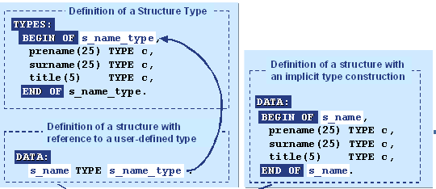
Defining structures
Variables
PRENAME (C25)
Resident 1
SURNAME (C25)
1234567890123
TITLE (C5)
ABC
PRENAME (C25) | SURNAME (C25) | TITLE (C5)
Resident 1 | 1234567890123 | ABC
Structure

Slide 32

Assigning structures
You address components of structures using: structure_name-comp_name.
For this reason, you should not use hyphens in variable names.

Slide 33
Assigning structures
Example:
DATA: v_date TYPE d.
DATA: BEGIN OF s_str,
year TYPE n LENGTH 4,
month TYPE n LENGTH 2,
day TYPE n LENGTH 2,
END OF s_str.
s_str-year = ‘2010’.
v_date = s_str. -> v_date = ‘20100000’.

Slide 34
Assigning structures
If all the components of a structure are of a string type, of fixed length, you can assign components with different properties to them. Each character is then copied byte-by-byte without being converted. This approach is used, for example, to extract the day or month from a date field.
That is, a structure is created, such that the first four characters of a variable specify the year, the next two specify the month, and the last two the day. If a date is assigned to this structure using the MOVE statement, the characters are then copied left aligned. You can then determine the year, month, and day directly using the variables, without having to use offsets.
For compatibility, assignments between incompatible structures are also allowed, if they contain numeric or hexadecimal components. The structure is then technically considered to be a string (that is, casting of the structure occurs). The contents are not converted. Between the structures, the same conversion rules apply as for strings: the bytes are copied, left aligned. If the target structure is longer than the source structure, the target structure is filled with spaces, regardless of the component type of the target structure.
In conclusion, avoid assigning incompatible structures wherever possible, except where both structures consist entirely of fixed-length string-type fields.

Slide 35
Assigning structures
You can copy the contents of a source structure to a target structure component by component, using a MOVE-CORRESPONDING statement. The system then copies each source field to the target field with the same name. The conversion rules for elementary data objects then apply.
Note that the system does not check that identically named components have the same type. This can be useful, but there are dangers involved.

Slide 36
Assigning structures
DATA: BEGIN OF s_resident,
name TYPE c LENGTH 20,
cnp TYPE n LENGTH 13,
address TYPE c LENGTH 25,
age TYPE i,
END OF s_resident.
s_resident-name = ‘Resident 1’.
s_resident-cnp = ‘1234567890123’.
s_resident-address = ‘ABC’.
s_resident-age = 24.
TYPES: BEGIN OF ty_student,
name TYPE c LENGTH 20,
stud_id TYPE n LENGTH 13,
address TYPE string,
END OF ty_student.
DATA: s_student TYPE ty_student.
MOVE-CORRESPONDING s_resident TO s_student.
MOVE-CORRESPONDING s_resident TO s_student.
NAME (C20) | CNP (N13) | ADDRESS (C25) | AGE (I)
Resident 1 | 1234567890123 | ABC | 24
NAME (C20) | STUD_ID (N13) | ADDRESS (STRING)
Resident 1 |  | ABC

Slide 37
Defining nested structures
You can define nested structures by assigning a structure type to a component within a structure type.
You can address this sub-structure as a whole using the component name: structure_name-substructure_name.
You can also address individual components in the sub-structure: structure_name-substructure_name-comp_name.
Structures can be nested to any depth.
You can also integrate components of a dynamic type in a structure. This can either be an elementary data object of variable length (string or xstring) or an internal table. These structures are known as deep structures.

Slide 38
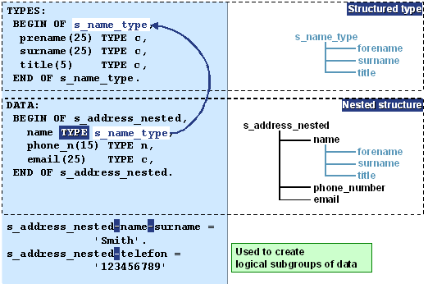
Defining nested structures

Slide 39
Assigning nested structures

Slide 40
DATA DECLARATION - Tables -

Slide 41
Tables
NAME (C20)
Resident 1
CNP (N13)
1234567890123
ADDRESS (C25)
ABC
AGE (I)
24
Variables
Structure
NAME (C20) | CNP (N13) | ADDRESS (C25) | AGE (I)
Resident 1 | 1234567890123 | ABC | 24
Table
NAME (C20) | CNP (N13) | ADDRESS (C25) | AGE (I)
Resident 1 | 1234567890123 | ABC | 24
Resident 2 |  | DEF25 | 30
Resident 3 | 1111111111111 |  | 12
Resident 4 | 2222222222222 |  | 45
A Table with a single column is the equivalent of a vector.

Slide 42
Tables
Each table is made of columns and rows.
Tables contain series of lines which are repeated from a single line.
One line may contain single element (equivalent of vectors) or multiple elements of same or different types.
Tables have a line type used to identify the table rows using unique or non-unique key.
Columns – object characteristics
NAME (C20) | CNP (N13) | ADDRESS (C25) | AGE (I)
Resident 1 | 1234567890123 | ABC | 24
Resident 2 |  | DEF25 | 30
Resident 3 | 1111111111111 |  | 12
Resident 4 | 2222222222222 |  | 45
Rows – objects
One or Multiple columns can be part of the Table Key.
The Key can be Unique (no duplicate) or Non-Unique (duplicate records).

Slide 43
Defining Tables in ABAP – Internal Tables
In ABAP, the tables defined locally (at program level) are called Internal Tables.
Example:
TYPES: BEGIN OF ty_student,
name TYPE c LENGTH 20,
stud_id TYPE n LENGTH 13,
address TYPE string,
END OF ty_student.
DATA: t_student TYPE TABLE OF ty_student. -> Internal Table Definition
DATA: s_student TYPE ty_student. -> Structure Definition
OBS: s_student and t_student have the same structure.

Slide 44
Initializing DATA objects
CLEAR structure.
All fields of the structure will have the initial value.
REFRESH itab.
Deletes all rows of the internal table.
NAME (C20) | CNP (N13) | ADDRESS (C25) | AGE (I)
Resident 1 | 1234567890123 | ABC | 24
NAME (C20) | CNP (N13) | ADDRESS (C25) | AGE (I)
 | 0000000000000 |  | 0
NAME (C20) | CNP (N13) | ADDRESS (C25) | AGE (I)
Resident 1 | 1234567890123 | ABC | 24
Resident 2 |  | DEF25 | 30
Resident 3 | 1111111111111 |  | 12
Resident 4 | 2222222222222 |  | 45
NAME (C20) | CNP (N13) | ADDRESS (C25) | AGE (I)

Slide 45
Internal tables - definition
Internal tables provide a means of taking data from a fixed structure and storing it in working memory in ABAP.
The data is stored line by line in memory, and each line has the same structure.
In ABAP, internal tables fulfill the function of arrays. Since they are dynamic data objects, they save the programmer the task of dynamic memory management in his or her programs. You should use internal tables whenever you want to process a dataset with a fixed structure within a program. A particularly important use for internal tables is for storing and formatting data from a database table within a program. They are also a good way of including very complicated data structures in an ABAP program

Slide 46
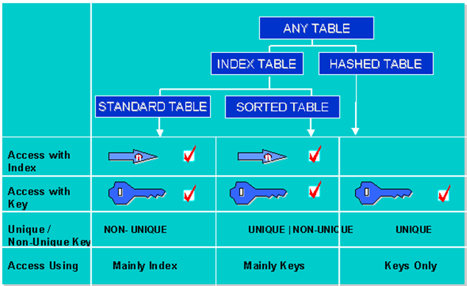
Internal tables - types

Slide 47
Standard tables
Standard tables have an internal linear index. From a particular size upwards, the indexes of internal tables are administered as trees. In this case, the index administration overhead increases in logarithmic and not linear relation to the number of lines. The system can access records either by using the table index or the key. The response time for key access is proportional to the number of entries in the table. The key of a standard table is always non-unique. You cannot specify a unique key. This means that standard tables can always be filled very quickly, since the system does not have to check whether there are already existing entries.
This is the most appropriate type if you are going to address the individual table entries using the index. Index access is the quickest possible access. You should fill a standard table by appending lines (ABAP APPEND statement), and read, modify and delete entries by specifying the index (INDEX option with the relevant ABAP command). The access time for a standard table increases in a linear relationship with the number of table entries. If you need key access, standard tables are particularly useful if you can fill and process the table in separate steps. For example, you could fill the table by appending entries, and then sort it. If you use the binary search option with key access, the response time is logarithmically proportional to the number of table entries.

Slide 48
First ABAP Program Hello World!

Slide 49
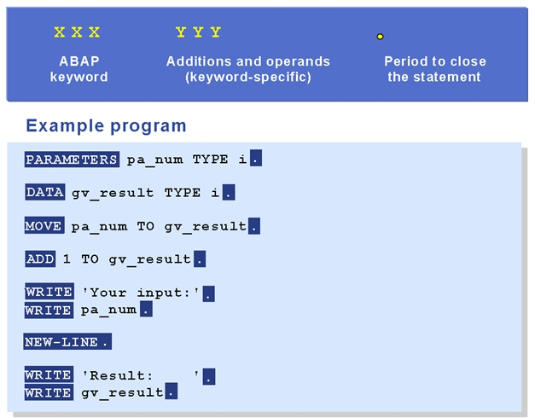
General ABAP Syntax I

Slide 50
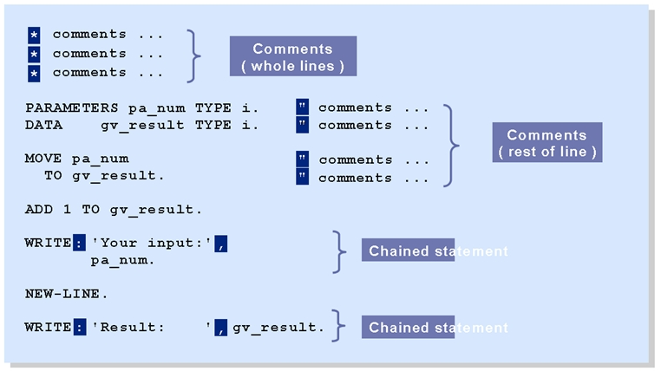
General ABAP Syntax II

Slide 51
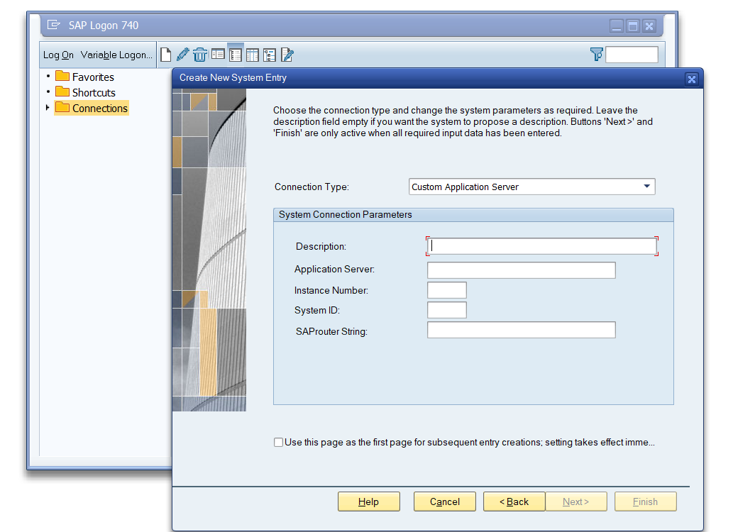
SAP GUI Logon
Open SAP Logon and create a new SAP Connection.

Slide 52
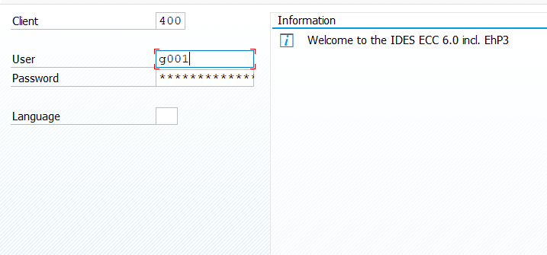
Login into System
Check the client and provided user/password (the default log on language is set on SAP GUI level and should be EN):

Slide 53
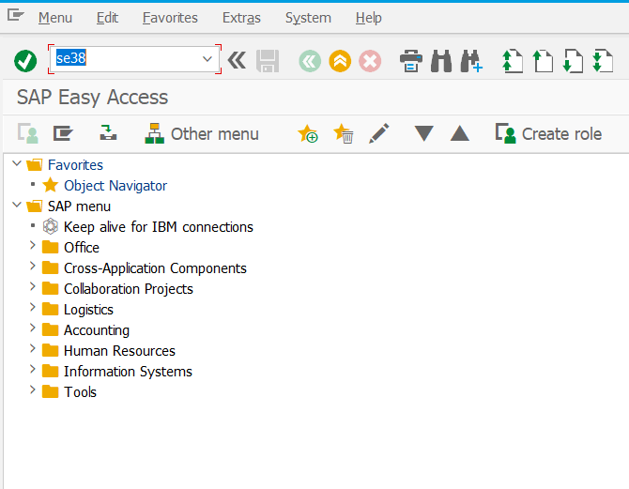
Open ABAP Editor
Open se38 transaction ( ABAP Editor ):

Slide 54
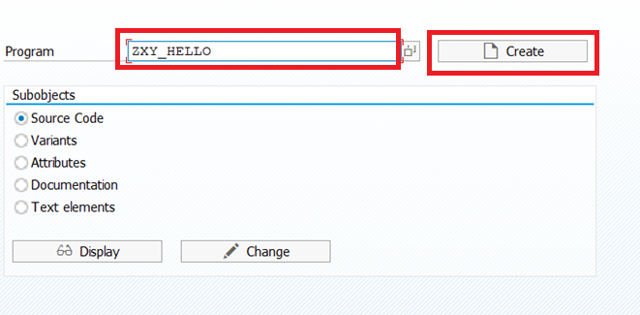
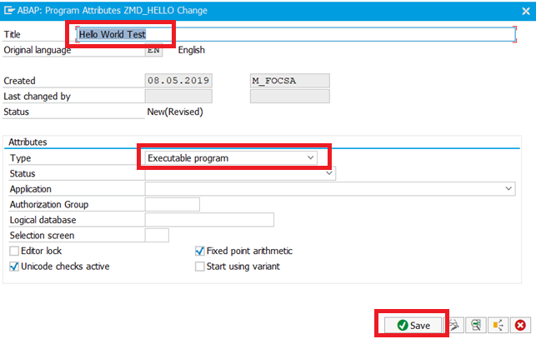
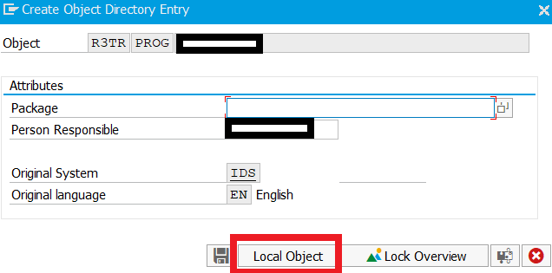
Create Report
1. Insert the report name ZXY_HELLO where XY are your initials and press Create button
2. Add a title and check the ‘Type’ = ‘Executable program’, and then press ‘Save’:
3. In the next screen press ‘Local Object’ Button

Slide 55
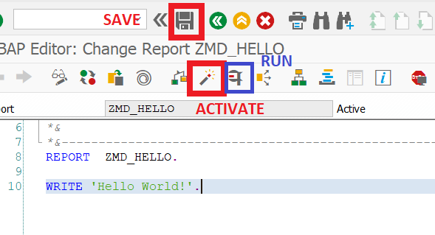
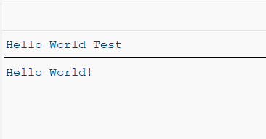
First Program
In the opened Editor insert the statement : Write ‘Hello World’.
After this press ‘Save’, then ‘Activate’ buttons. After this is done press ‘Run’:
This should be the result, your first report:

Slide 56
Time to Practice

Slide 57
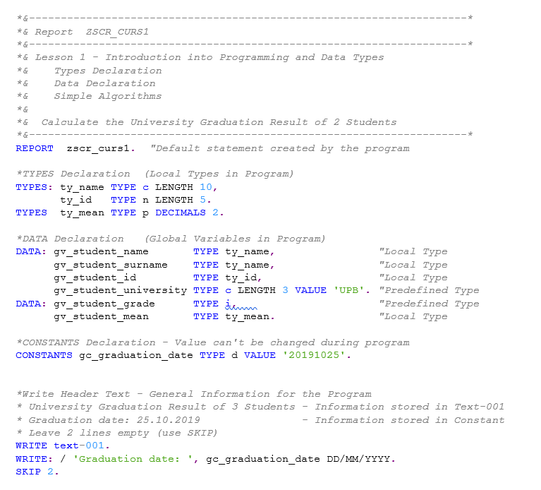
Time to Practice: Write this report and Execute
Program Name: ZZuser_C1
*where user is your login user (eg: ZZg001_C1) -> OBS: name must be unique in the system!!!

Slide 58
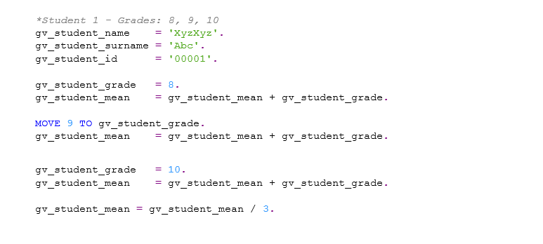
Time to Practice: Write this report and Execute

Slide 59
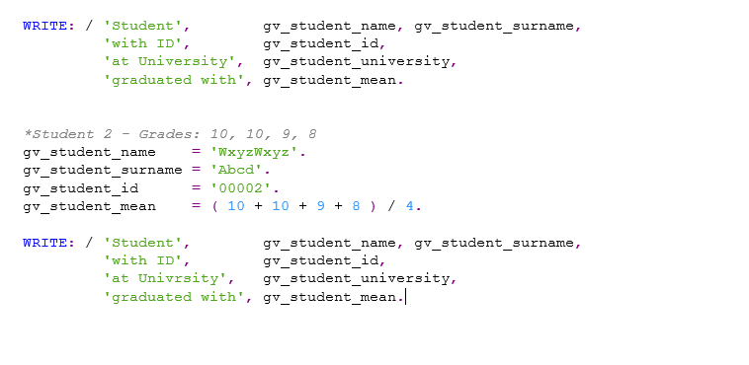
Time to Practice: Write this report and Execute

Slide 60
Time to Practice: New requirement
In the same report, declare a complex TYPE (ty_student) with 5 components: name, surname, id, university and mean.
Declare a structure (s_student) using the above type and fill it with corresponding values. The student should have the same university as Student 1 and 2.
The student has the following grades: 8, 8, 9 and 7. Calculate the student mean and display the information.

